Slide 1



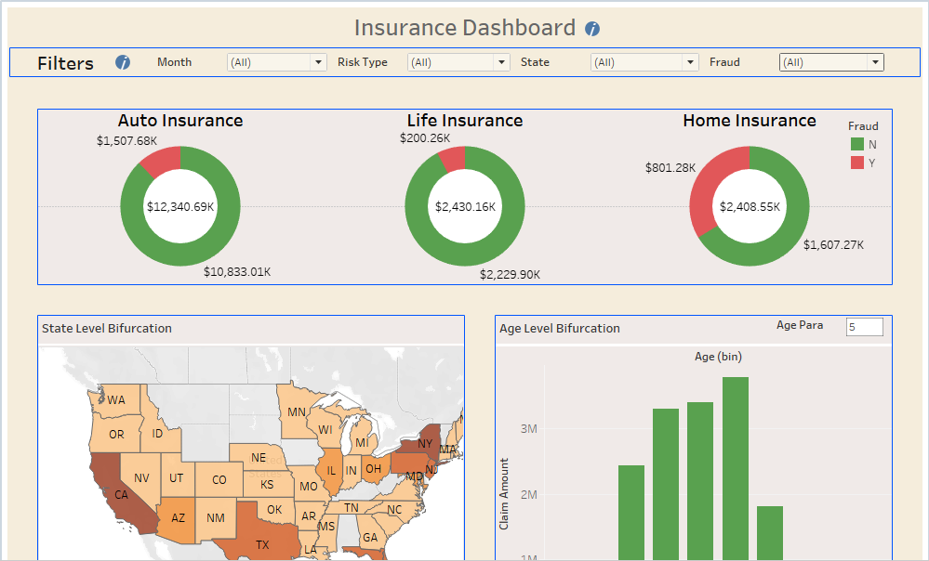
Insurance Dashboard
Motive
Analytics Pipeline
Major Challenges
Since there are many claims are come for settlement so need to identify which claim need to settle and which need to check again or put in verification and how to reduce claim amount by idenfiy fraud claims
Our Solution
Here we can track claim settlement submission with different three part and then we can check on geography level as well on there occupation and age level.
For fraud identification check claim submission and policy purchase time as well risk level for that claim policy.
We can decide updated premium based on age and occupation and risk level and
Marketing Tools and Platforms
Data Transformation
Business Intelligence Tools
Data for insurance customers and poly taken from customer data platform.
Policy are update on company portal which used for same
Data received from the different portals which stored and used by Excel sheet here and SQL
Monthly refresh planned for dashboards (Field and HQ).
Track geography, occupation, age level data
Identify top claimer in each segment as well
Dashboard Sample and Use Case
Dashboard
Benefits
Dashboard help to decide premium from next term based in Age, Occupation, Territory level
Dashboard help to identify major fraud claim from which territory.
Also we can check based on education and occupation level for claim submitters
Top claim policy and detail policy report generated overall .
This dashboard shows a portion of what information can be viewed by employees at the HQ.
The use case shown here is for the traking of claim on monthly settlement and howmany fraud claims identify also from which territory major claim identify as fraud and how to trat them and which category we can put them for next term
Also we can decide next premium based on age and occupation based risk criteria
Also we can identify top claim submitted person in each segment or identify frequncy of claim submission
* Estimated

